Slide 1


Data-Driven Storytelling Presentation:
ACCOUNT PERFORMANCE METRICS
AND
SALES TREND
BY
TARINI PRASAD DAS

Slide 2
INTRODUCTION
Problem Statement
• J.P. Morgan Chase & Co. is a leading global financial services firm that offers services and operates worldwide.
• The company aims to analyze the account performance metrics over the last 5 years (2017-2021) and the factors contributing to its compound annual growth rate (CAGR) in unit sales. This includes identifying opportunities for further improvement.
Business Questions
• Examining the total unit sales for each year.
• Analyzing the year-over-year growth in sales.
• Identifying which account types are surpassing others in terms of unit sales.
• Calculating the average 5-year compound annual growth rate (CAGR) based on different account types.
• Evaluating the top-performing and bottom-performing accounts

Slide 3
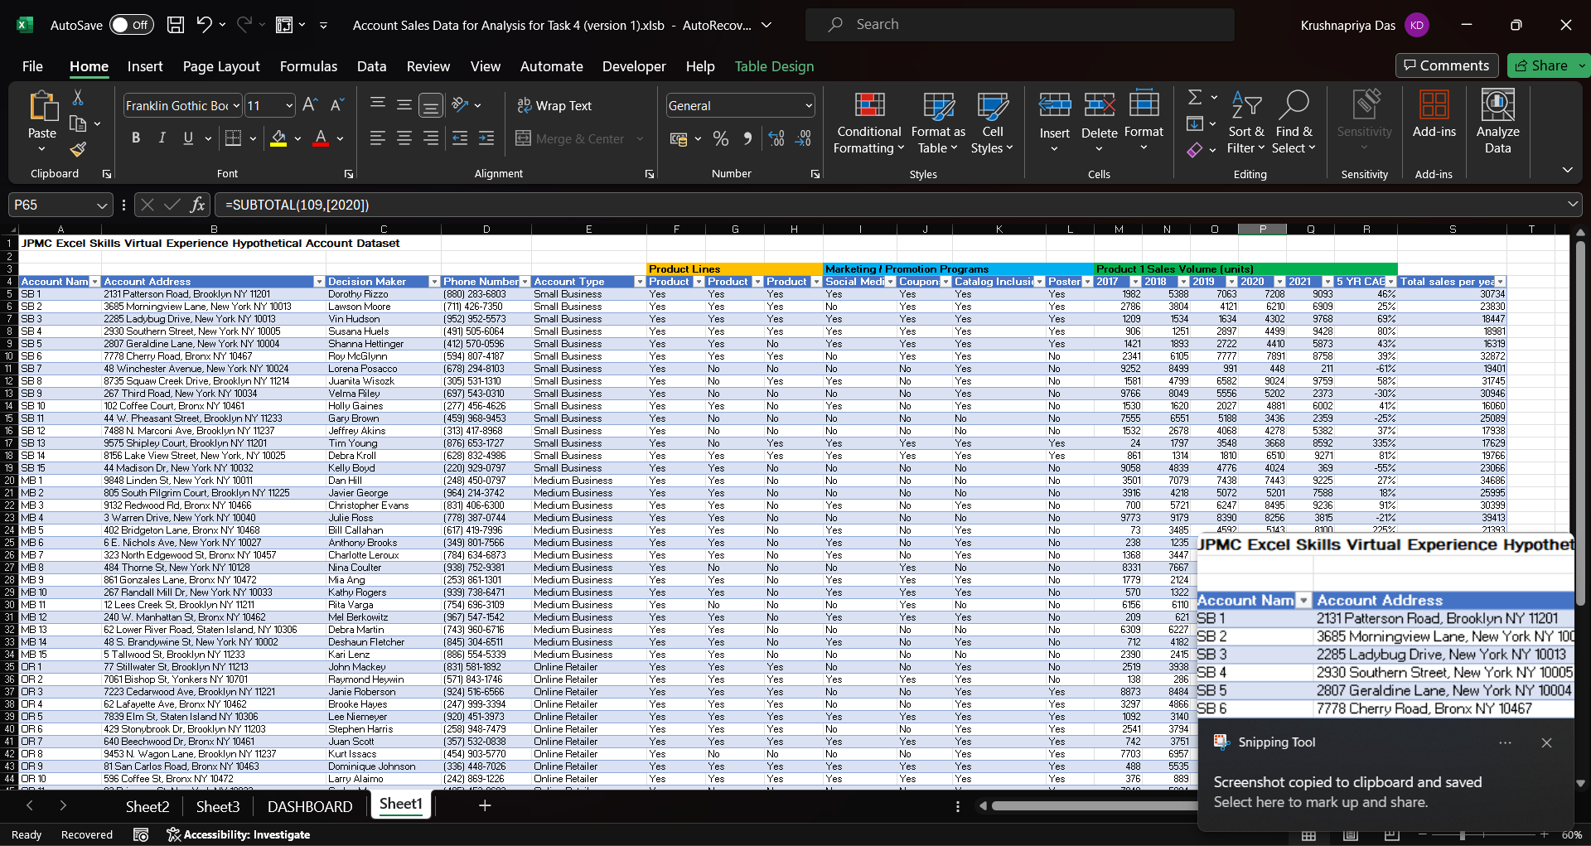
DATA MODELLING
Utilizing Power Query in MS-Excel, transformed the data for improved organization, giving a more structured foundation for necessary analysis.

Slide 4
DATA ANALYSIS AND VISUALIZATIONS
Overall, our unit sales growth has been good, with a 5- year CAGR of 21%.
Online Retailer generated the highest sales volume, totaling 408,515 units, which accounts for 28% of the total sales volume. Medium Business followed closely with a sales volume of 380,568 units, making up 26% of the total sales volume.

Slide 5
DATA ANALYSIS AND VISUALIZATIONS
Directing our sales resources and adjusting our sales all type of account types are getting most sales in the year 2021 followed by 2020.

Slide 6
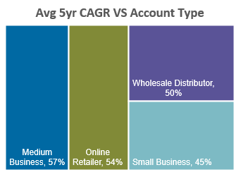
DATA ANALYSIS AND VISUALIZATION
From the pie chart we can find that online retailers have got the overall maximum sale followed by medium business and wholesale distributors got the minimum sale.
From the TREE MAP we can see that medium Business got the max average 5yr CAGR of 57%.

Slide 7
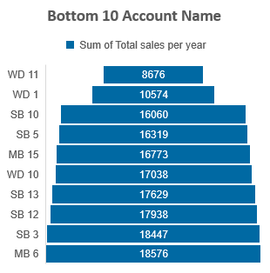
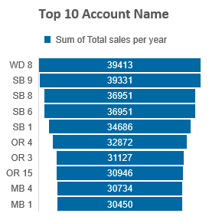
DATA ANALYSIS AND VISUALIZATION
The account name WD8 proved to be the highest-performing account, achieving an impressive sales volume of approximately 39,413 units. On the other hand, accounts WD11, WD1, and SB10 performed at the lowest level in terms of sales volume. Specifically, WD11 accounted for 8,676 units, WD1 for 10,574 units, and SB10 for 16,060 units, all in terms of sales volume

